Slide 1
EMAIL SPAM PREDICTION
Name: Gaurav Gupta
Roll No: 1901068

Slide 2
Problem Statement
We have to create a Machine Learning Algorithm that can Classify the Spam and Ham(Not Spam) Emails.

Slide 3
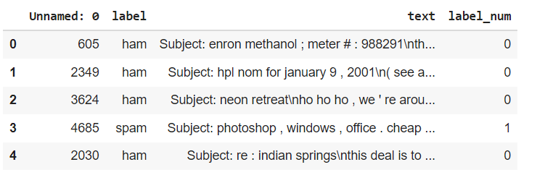
About the Dataset
The Dataset used in this project is a CSV format file containing 4993 unique emails with 71% not Spam emails and the remaining 29% Spam emails.
The Data Frame generated is as :

Slide 4
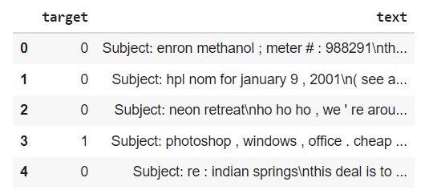
Minimizing the Dataset
The Original Data Frame consisted of 4 Columns. So I reduced it into just 2 Columns one for the text and other for the Target or the Label.

Slide 5
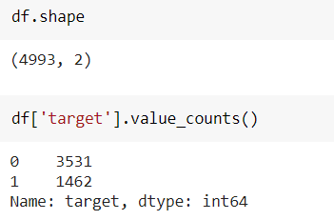
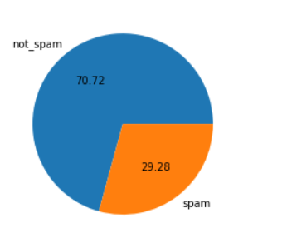
Data Cleaning
To Clean the Data Set I removed the Missing Values and also removed the Duplicate items.
Finally the Data Set looked like this

Slide 6
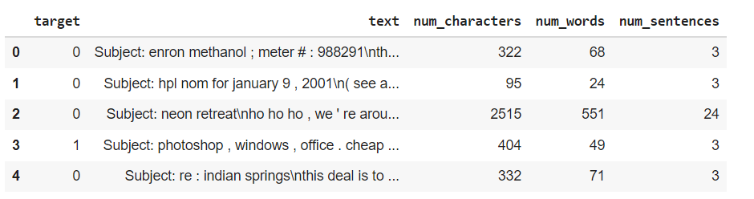
Data Analyzing
Now we analyze the Emails by checking the no of words, characters, sentences in each email.

Slide 7
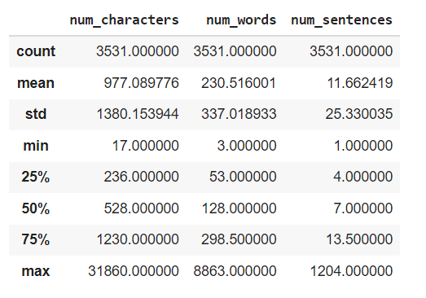
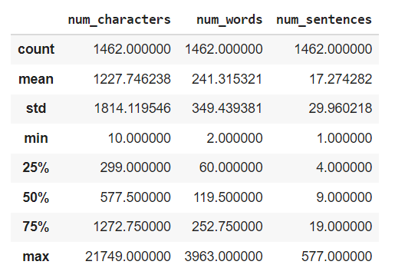
Ham Emails
Spam Emails

Slide 8
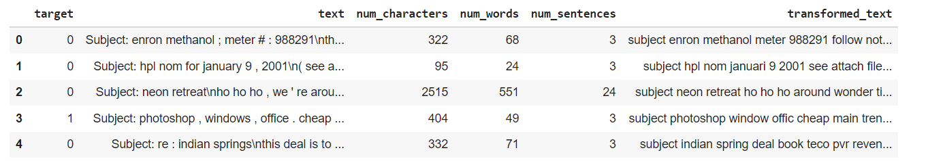
Data Preprocessing
Data Preprocessing includes :
Lower Case
Tokenization (Converting Sentences into words)
Removing Special Characters
Removing Stop words and Punctuations
Stemming (Removing similar Words)

Slide 9
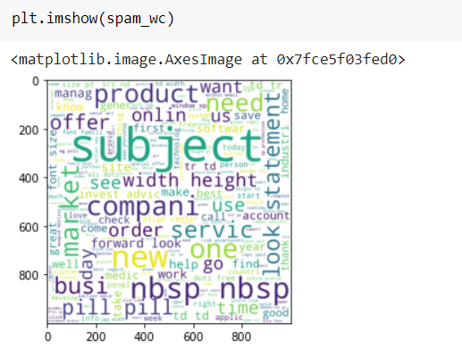
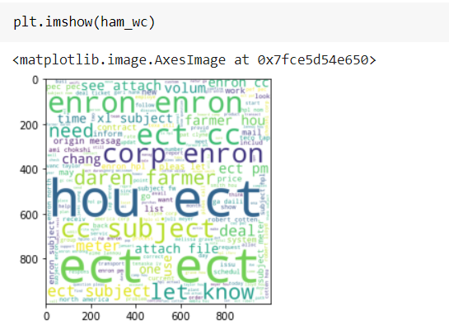
Analyzing Similarities in Data
Now we analyze the Frequent words in Spam and Ham Emails

Slide 10
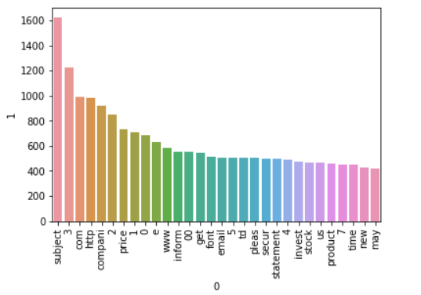
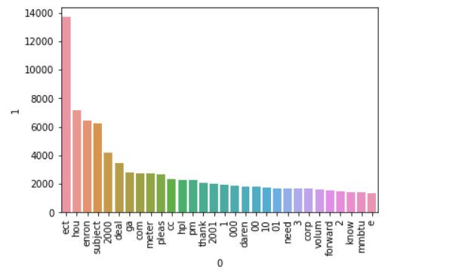
Spam Emails
Ham Emails

Slide 11
Model Building
This consists of three major parts:
Vectorizing the Data: We separate each of the transformed text into a list of words. This can be done with Count Vectorizer or TFIDF Vectorizer. In this Project I have used the TFIDF vectorizer as it gave me better results.
Splitting the Data Set: Now as we Split the Data set into Test Set and Train Set.

Slide 12
Training the Data Set: Now we have to choose a suitable Algorithm to train our Data Set. Since this is a Classification problem we can use Logistic Regression to Implement the Model. But I checked with other Models as well to get the best results and recorded their Accuracy and Precision.

Slide 13
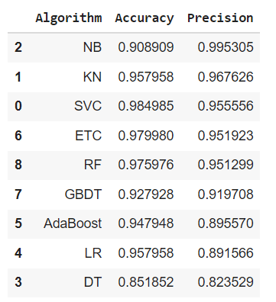
BEST PRECISION

Slide 14
From the Table we can clearly see that Multinomial Naïve Base is the best Algorithm to work with as it has the best Precision and Accuracy as compared to other Algorithms.

Slide 15
Creating Web App for the Model
Now as we Created the model I made a Web App for the same using Streamlit Library in Python.
Firstly, we have to pickle our model. Pickling the model helps to serialize the model to create a .pkl file which can be used to implement the model in other place. Here I used Scikit Library to pickle my model and used the .pkl file to create a web interface using streamlit and to finish things up Deployed the web app using Heroku. Here is a link to my Web App :

